Slide 1
Good Morning AP Bio!
Turn in your Quiz Corrections.
(3 minutes!)
Review the Socratic Seminar article and your Reading Aid.

Slide 2
Socratic Seminar
Origin of Life: Power Behind Primordial Soup Discovered
AP Biology

Slide 3
Socratic Seminar
Norms
Listen: No one can speak while someone else is speaking
Respect: There are no bad comments
Participate: Everyone must contribute
Build: Speakers must try to build on what others say, not debate their views
Refer to Text: Speakers must refer directly to the paragraph of the text from which their ideas come, rather than making general observations.

Slide 4
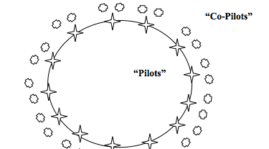
Format
3
2
1

Slide 5
Socratic Seminar
Outer Circle
No talking
Use sticky notes to pass comments to inner circle
Complete observation form
You will have opportunities to discuss in small groups, and when you switch to the inner circle

Slide 6
Questions: Origin Of Life
Why was this an important experiment?
What is ATP?
Describe the compound scientist found during their experiment.
What does this compound have to do with ATP?
What do the results of the experiment indicate?
Summarize the evidence presented and conclusions drawn in this article.
Do you agree or disagree with the conclusions of the authors? Justify your response with evidence!

Slide 7
Questions: Origin Of Life
How could the experiment be improved?
Describe follow up experiments that should be conducted.
Predict the results of future similar experiments.
What hypothesis does the discovery of phosphorus on Mars support?
Summarize two follow up experiments currently underway (paragraphs 12 & 13).
Speculate on what scientist may discover in these two experiments.
Which experiment would most strongly support the conclusions put forth in this article? Why?

Slide 8
Socratic Seminar Observation/Evaluation Form
Make sure you have completed the observation form. Please be THOROUGH in your summaries of student comments.
Homework: Complete the Socratic Seminar Evaluation and the analysis questions. Again, please be THOROUGH!

Slide 9
WARM UP: Socratic Seminar Reflection
What did you learn about the scientific process from reading this article and participating in the seminar?
Summarize the main points you made in your evaluation form.
Do you believe that evolution is predictable? JUSTIFY your answer with evidence!

