Slide 1
Good Morning AP Bio!
Review the article and have it out in front of you so I can check for completion.
If you didn’t yesterday, turn in your Cosmos assignments. (On table)
Turn in your AP Readiness form. Make sure I can clearly read your name!!! (On table)

Slide 2
Socratic Seminar
Lookalike Lizards & Convergent Evolution
AP Biology

Slide 3
Socratic Seminar
Norms
Listen: No one can speak while someone else is speaking
Respect: There are no bad comments
Participate: Everyone must contribute
Build: Speakers must try to build on what others say, not debate their views
Refer to Text: Speakers must refer directly to the paragraph of the text from which their ideas come, rather than making general observations.

Slide 4
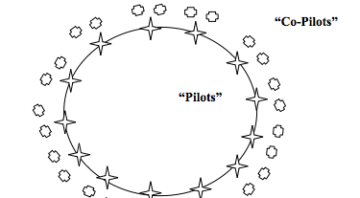
Format
3
2
1

Slide 5
Socratic Seminar
Outer Circle
No talking
Use sticky notes to pass comments to inner circle
Complete observation form
You will have opportunities to discuss in small groups, and when you switch to the inner circle

Slide 6
Questions: Lookalike Lizards
Why are anoles good candidates for evolutionary studies?
Describe what “convergence” or “convergent evolution” means?
Summarize the evolutionary argument that Jay Gould made.
Do you agree or disagree with the ideas of Gould? Justify your response with evidence!
How did Mahler go about testing these ideas? Be specific!

Slide 7
Questions: Lookalike Lizards
Describe what Mahler means when he says “battle-tested” traits?
What is an “adaptive landscape” and how is it relevant to evolution?
What other examples does Mahler provide to support his ideas?
Do you believe that evolution is predictable? Justify your response with evidence.
Speculate on how differences in “ancestral material” might change the outcome of this study.

Slide 8
Socratic Seminar Observation/Evaluation Form
Make sure you have completed the observation form. Please be THOROUGH in your summaries of student comments.
Homework: Complete the Socratic Seminar Evaluation. Again, please be THOROUGH!

Slide 9
WARM UP: Socratic Seminar Reflection
What did you learn about the scientific process from reading this article and participating in the seminar?
Summarize the main points you made in your evaluation form.
Do you believe that evolution is predictable? JUSTIFY your answer with evidence!

