Slide 1
Socratic Seminar
Epigenetics
AP Biology

Slide 2
Socratic Seminar
Norms
Listen: No one can speak while someone else is speaking
Respect: There are no bad comments
Participate: Everyone must contribute
Build: Speakers must try to build on what others say, not debate their views
Refer to Text: Speakers must refer directly to the paragraph of the text from which their ideas come, rather than making general observations.

Slide 3
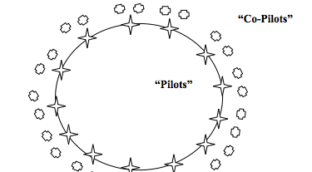
Format
3
2
1

Slide 4
Socratic Seminar
Outer Circle
No talking
Use sticky notes to pass comments to inner circle
Complete observation form
You will have opportunities to discuss in small groups, and when you switch to the inner circle

Slide 5
Questions: Epigenetics
What is Epigenetic inheritance?
How does it differ from genetic inheritance?
What is methylation? Acetylation?
How do these biochemical flags affect gene expression?
How does our diet affect gene expression?
How does our environment affect gene expression?

Slide 6
Questions: Epigenetics
Differentiate between the research questions asked in these two articles/experiments?
How does each study help to answer the research question?
What controls were used in these studies?
Summarize the results and conclusions of both experiments.
What future studies could be planned to help understand epigenetic inheritance?
How would you design those studies? (What would be your experimental setup/controls/etc and how would you interpret your results?)

