Slide 1
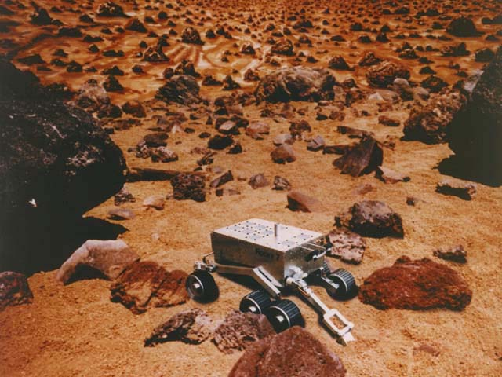
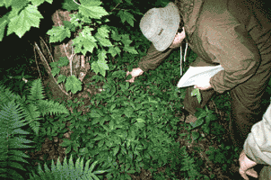
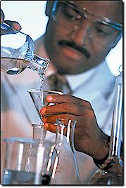
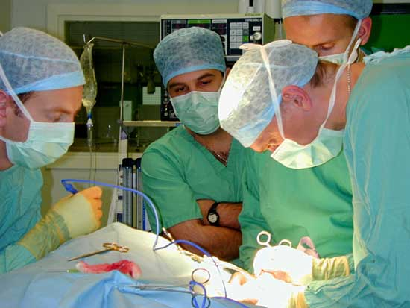
The Scientific
Method

Slide 2
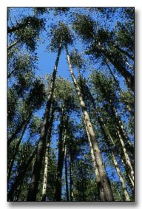
Observation and Hypothesis
1st step: Make an observation
Example: Why is there little ground vegetation in this forest?
2nd step: Create a hypothesis
If…then statement
Example: If there are tall trees blocking sunlight, then few plants will grow near the ground.

Slide 3
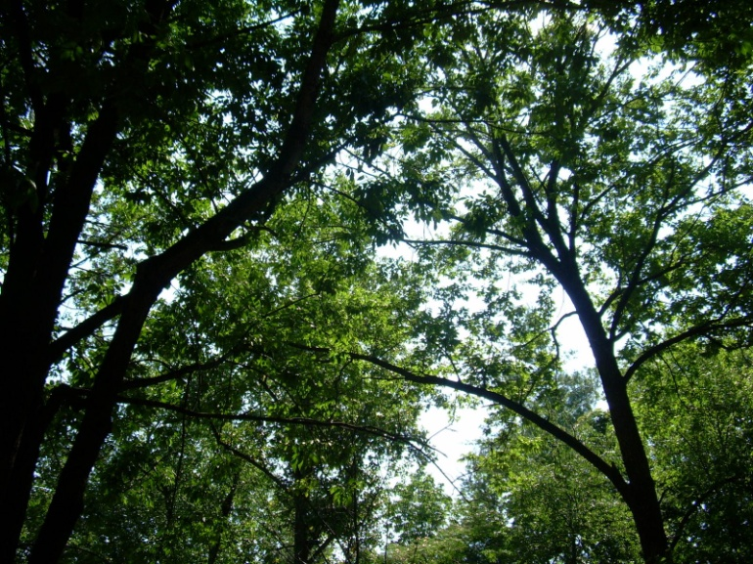
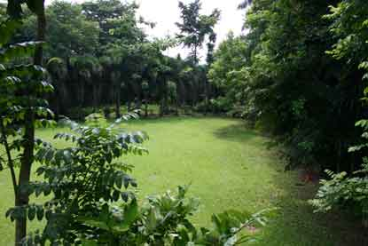
3rd step: Design an Experiment
Two parts to an experiment:
Control group
Receives no special treatments
Used as comparison
The “normal” group
2) Experimental Group
Receives the treatment
Contains the independent variable
Independent variable = one factor that differs from the control group
Data collected is called the dependent variable

Slide 4
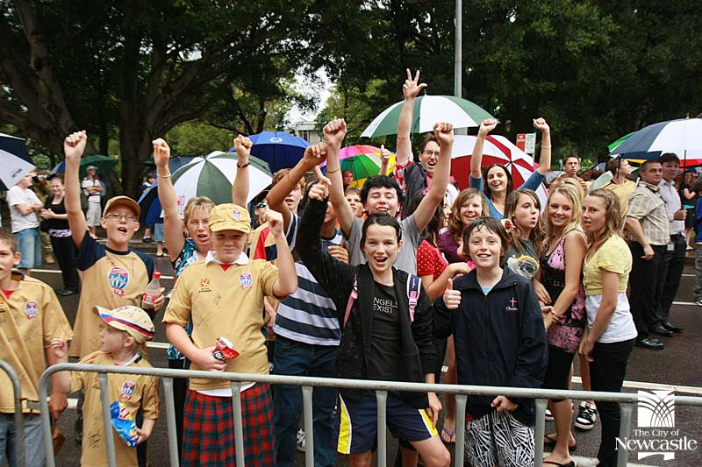
Here is a well designed setup

Slide 5
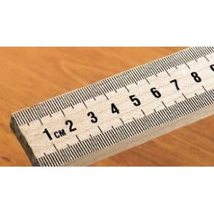
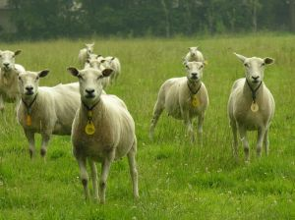
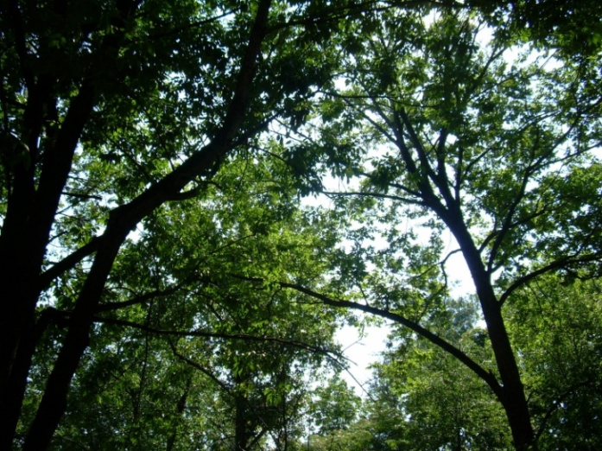
Control Group
Experimental Group
6 hours sun/day
8cm rain/month
6 hours sun/day
8cm rain/month
Grazing animals
60⁰ temp
60⁰ temp
Grazing animals
Large canopy trees
Patch of open land
The experimental plants grew 1 meter taller. What most likely caused this change?

Slide 6
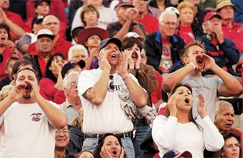
Here is a poorly designed setup

Slide 7
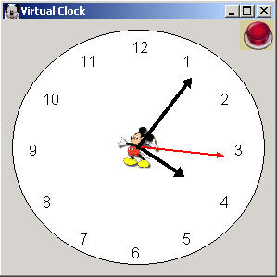
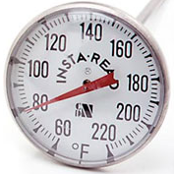
Control Group
Experimental Group
6 hours sun/day
8cm rain/month
8cm rain/month
4 hours sun/day
Grazing animals
80⁰ temp
60⁰ temp
Grazing animals
Large canopy trees
Patch of open land
The experimental plants grew 1 meter taller. What most likely caused this change?
Unknown! Too many changed variables!

