Slide 1
Cell = City

Slide 2
Think of a City
How does it operate?
Who protects the city?
Who runs the city?
How does the city manage its trash?
How does the city get food?
How does the city get its power?
How do you know when you are in the city limits?

Slide 3
A cell can be compared to a city!
Each part of the cell has its own function or purpose.
The parts of the cell can be compared to the parts of a city based on their similar purpose.

Slide 4
Cell Part | City Analogy | Function
A. Cell | City | Area with fixed boundary
B. Cell Membrane | City Limits | Surrounds, protects & borders
C. Cytoplasm | Environment | Inner space
D. Nucleus | City Hall/Courthouse | Controls the activities
E. Nuclear Membrane | Police Force | Protects
F. Ribosomes | Factory & Workers | Makes products
G. Endoplasmic Reticulum/Cytoskeleton | Roads or Highways | Transportation system
H. Golgi Bodies | Post Office or UPS | Packs & carries
I. Mitochondria | Power Plant | Provides power
J. Lysosomes | Recycling Plant or Waste Management | Recycle & waste disposal

Slide 6
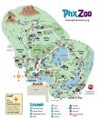
Create a City Cell Analogy
You can use a city or any other place (amusement park, country, the mall).
Can be a fictional place.
Steps of the Project:
  Step 1: Brainstorm on the cell parts and what you can draw to represent each part. Use the City Analogy to help you.
  Step 2: Draw a picture of your city. Label each “cell” part of the city with a letter A through J.
  Step 3: Create a legend or map key in the corner and explain what A – J represent. Ex: D = Town Hall
  Step 4: In complete sentences, write your analogies. This will explain why you selected each part of your city to represent the part of the cell and what function they both share.

Slide 7
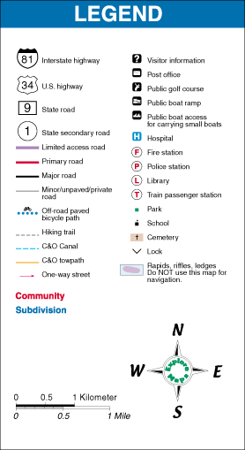


Create your map and legend.
Draw your city. Pencil first, then crayons, markers or colored pencils.
Label each part on your city A – J. Circle the letter.
Create a map legend or key in the corner of your map which lists the letters A-J and identifies the name of each place.
  Example. A= Far Far Away;
  B=city limits

Slide 8
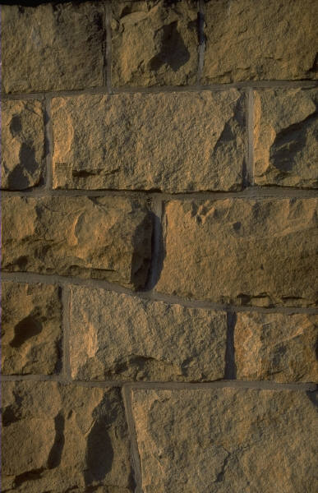
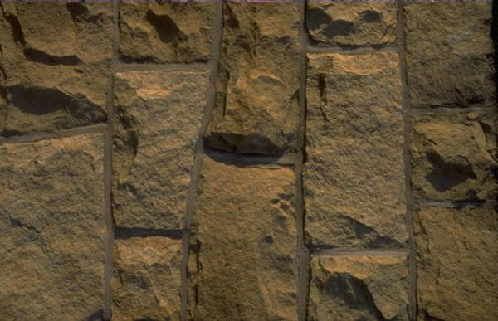



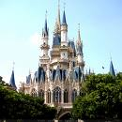














A
I
C
D
G
B
H
J
E
Legend
A: Far Far Away
B: Brick Wall
C: Environment
D: Shrek’s Castle
E: Puss-n-boots Security Service
F: Gingerbread Man’s Cookie Factory
G: Roads
H: 3 Blind Mice Delivery Service
I: Dragon Power Service (DPS)
J: Donkey Recycling
F

Slide 9
Explain why you chose the items to represent each cell part
List the letters A-J
For each letter:
  State the name of the place/character
  The name of the cell part it corresponds to
  Why you selected that item to represent the cell part
Must be in complete sentences.
  Example: D: The city hall/courthouse represents the nucleus because its function is to control the town’s activities
On notebook paper.

Slide 10
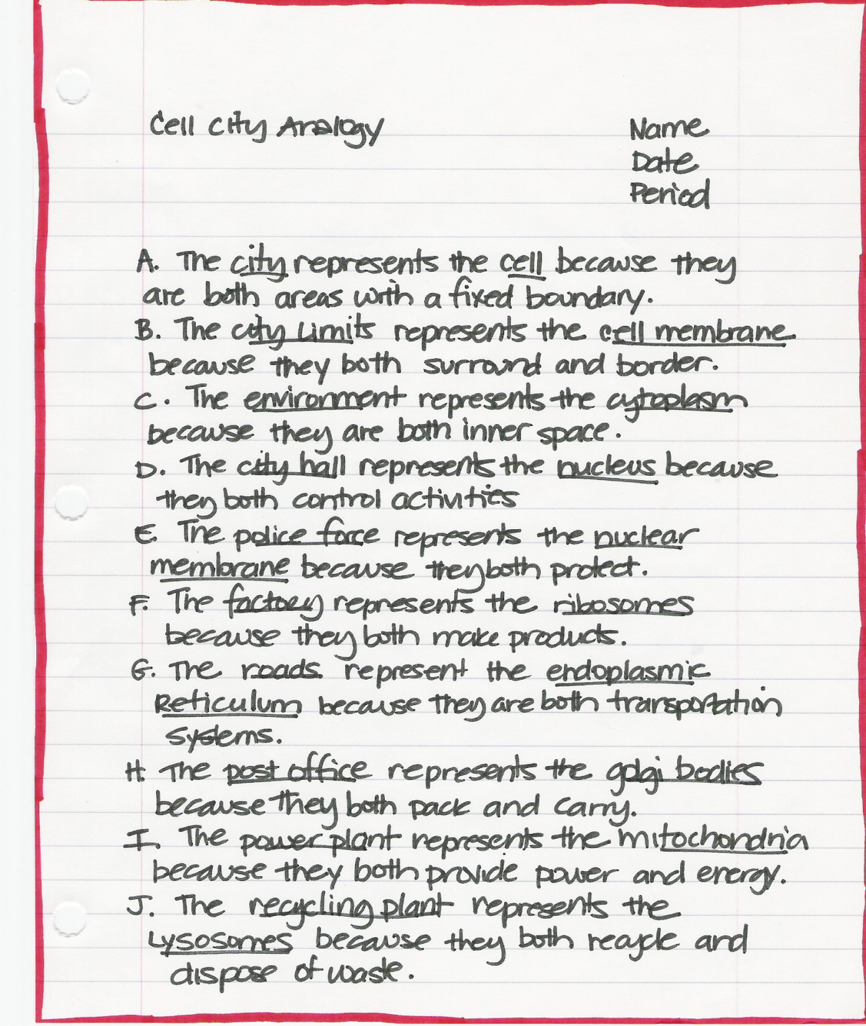




Slide 11


Final Product:
Your analogies must be in complete sentences and stapled/glued to the back of your map.
Your map/picture must be neat, colorful, correctly labeled, and have a legend or key.
Use pencil first then color.
Be creative! Have fun with it.
Past examples included underwater cities, prehistoric cities, a skate park, amusement parks, a mall, video games, a school, a hospital, etc…

Slide 12
Cell Part | City Analogy | Function
A. Cell | City | Area with fixed boundary
B. Cell Membrane | City Limits | Surrounds, protects & borders
C. Cytoplasm | Environment | Inner space
D. Nucleus | City Hall/Courthouse | Controls the activities
E. Nuclear Membrane | Police Force | Protects
F. Ribosomes | Factory & Workers | Makes products
G. Endoplasmic Reticulum/Cytoskeleton | Roads or Highways | Transportation system
H. Golgi Bodies | Post Office or UPS | Packs & carries
I. Mitochondria | Power Plant | Provides power
J. Lysosomes | Recycling Plant or Waste Management | Recycle & waste disposal

Slide 13
Cell Part | City Analogy | Function
A. Cell
B. Cell Membrane
C. Cytoplasm
D. Nucleus
E. Nuclear Membrane
F. Ribosomes
G. Endoplasmic Reticulum/Cytoskeleton
H. Golgi Bodies
I. Mitochondria
J. Lysosomes

